Slide 1
Roots of Hope
Healing and growing guidance from personal hardship
Peter F. Morneault

Slide 2
Roots of Hope
Written by Peter F. Morneault
Copyright 2021.
All Rights Reserved.
If you wish to use any portion or the entire contents of this eBook, please attribute to Peter F. Morneault.
You may print, email, or share this eBook. It is meant to be distributed, for free.
Editing/Creative Consulting: Melissa Passarello
www.petermorneault.com

Slide 3
Thank You
For downloading this eBook.
For no longer hitting the snooze button on your life.

Slide 4
The Mission of This eBook?
To inspire and encourage people to answer their wakeup calls so they can experience a more fulfilling future.

Slide 5
This eBook Is For
People who have hit “rock bottom” and want to change the status quo of their lives.
People who have been scared into living.
People who won’t quit when the going gets tough.

Slide 6
I Am Not
A doctor.
A nutritionist.
A psychologist.
An exercise guru.
A spiritual adviser.

Slide 7
I Was
Naïve.
Misled.
Extremely sick, but I didn’t know it.
Misinformed.
Scared.
Lucky.
Damn lucky.

Slide 8
I Am
A husband, a son, a brother, a friend,
a co-worker, and a stranger.
Ordinary, average, and middle-of-the road.
Hopeful. Optimistic.
Just like you.

Slide 9
The Good, The Bad, And The Ugly
An emergency room doctor told me:
“The good news is that you’re still alive.”
I asked, “What’s the bad news?”
“You’re not going home tonight.”
The ugly truth: I suffered a heart attack.

Slide 10
From Ugly to Disabled
During a surgery to clear a blocked artery in my heart, a chunk-of-junk choked my brain of life-giving blood.
In other words, I suffered a stroke.
That was my life-changing event. What’s
yours?

Slide 11
Now What?
As a tree needs a healthy root system to thrive and grow, we need a nourishing system to help us survive, heal, and rehabilitate.
Our physical, emotional, mental, and spiritual bodies, or roots, need nurturing.

Slide 12
Root One: Physical Health
The Symptoms: Disability led to disbelief, disappointment, and discouragement. Have you experienced these ailments before?
The Remedy: An occupational therapist taught me how to tie my shoes. A physical therapist taught me how to walk again. A speech therapist taught me how to shout with joy.

Slide 13
Hard Work Pays Dividends
When you choose a mindset of living, rather than avoidance of dying, your body will respond with greater efficiency and effectiveness.
The hospital sent me home two weeks early.
You too, can exceed expectations and
defy the odds stacked against you.

Slide 14
A Plan For Physical Healing
Keep moving. Challenge your muscles everyday.
Stress, worry, and anxiety are stubborn, but they will leave.
Effort becomes habit. Habit becomes routine.
Routine becomes a way of life.

Slide 15
Root Two: Emotional Health
While in an intensive care unit, my wife, Cathy, asked me, “Why are you crying?”
“I don’t know.”
A nurse said, “You have a brain injury and will have a hard time controlling your
emotions.”
We all have emotional injuries of some sort.

Slide 16
You Are Not A Victim
I was the youngest attendee at a stroke survivors support group meeting.
A fellow sufferer told me, “You have been given a second chance to live. What are you going to do with it? You, my friend, are not a victim. You are a survivor!”
And if you are reading this, you are a
survivor too.”

Slide 17
Life Got Worse
I felt like a burden to my wife, Cathy, who had become my caregiver, nurse, and therapist.
Our struggle to survive and the pain of fresh “wounds” cut much deeper than we showed.
One heart attack and one stroke, but
two survivors.

Slide 18
What’s Important Now?
A holistic nurse and wellness counselor taught us three valuable words to use in combating our negative emotions.
What’s Important Now?
Not next year, next month, next week or tomorrow.
Now
W-I-N

Slide 19
A Plan For Emotional Healing
Victims ask, “Why Me?” Survivors ask, “Why Not Me?”
Don’t let your ego prevent you from seeking the help you may need.
A friend, a priest, your dog, or your cat can be a beneficial support system.
Get sad. Get mad. Get frustrated. Let your emotions flow.
Then Let Them Go.

Slide 20
Root Three: Mental Health
On the surface, we may seem recovered from our damaged lives.
However, obstructions and reconstructions can quietly and unexpectedly haunt us.
For me, I live every day knowing I still have
three blockages in various parts of
my brain.

Slide 21
Silence Is Golden
Mental activity is the medicine for my brain.
Make repeated attempts to quiet your mind, to embrace silence, and to be comfortable with boredom.
Sometimes, doing nothing is an incredible
mental exercise that pays enormous
dividends.

Slide 22
Do. Or Do Not.
As the old sage, Yoda, says to a young Luke Skywalker in The Empire Strikes Back movie, “Try not. Do. Or do not. There is no try.”
We all have our mental homework to DO.
Every day, focus on achieving more than you did the day before.

Slide 23
A Plan For Mental Healing
Reading and learning is a good prescription for recovery and growth.
Balance activity with rest.
A healthy mind can nourish a physical body, and a healthy body can strengthen a troubled mind.
An attitude of gratitude is being kind to
yourself.

Slide 24
Root Four: Spiritual Health
You may believe God created the Earth, or you may believe in the Big Bang Theory.
You may believe in astrology, numerology, or parapsychology.
You may believe in Santa Claus, unicorns, the Tooth Fairy, or leprechauns.
My point is:

Slide 25
Be Unique
My religious and spiritual beliefs are mine.
Yours belong to you.
You don’t have to share your beliefs with others, but you need to be comfortable with your choice.

Slide 26
Spirituality Surrounds Us
Surfers can get high-on-life when they catch a perfect wave.
Why do we experience déjà vu?
Something may alert you to slow down seconds before an auto accident occurs in front of you.
Embrace The Weirdness of life.

Slide 27
The In-Between
We are neither in total control, nor totally out of control of our lives.
Life is not black or white. It is gray.
Science versus Religion.
Spirituality lies somewhere in between.

Slide 28
A Plan For Spiritual Healing
Believe that something, in addition to your conscious awareness, contributes to your overall well-being.
Believe in a blend of religion, science, and philosophy.
Be at peace with your spiritual beliefs. For peace brings harmony.
Harmony is healthy.

Slide 29
Putting It All Together: My example
I made up my mind to do more than I did the day before. I concentrated intently on the actions of my muscles as I pushed a vacuum. I pushed through the fatigue of the physical exercise, but I finished what I started. When Cathy came home, I saw surprise and relief in her expression. I had done something to ease her burden. I showed that I cared. Before I fell asleep that night, I prayed to God and thanked Him for
allowing me to have a healthy day.

Slide 30
Summary
We are like trees. We may be young or old, fragile, weak or damaged, but we can grow stronger if we have hope.
Our Physical, Emotional, Mental, and Spiritual bodies work together, like the roots of tree, to nourish our health.
Each one of us is unique, like no two trees are of equal size, shape, strength, or beauty.
We are all apprentices with a potential to become masters of our own well being.

Slide 31
Conclusion
I hope my sharing of a traumatic life experience in this eBook will inspire you to take active control of your life.
Feed your roots and help them work together for one common goal:
To Make You Healthier, Happier, and Truly Alive.
Peter,
The survivor

Slide 32
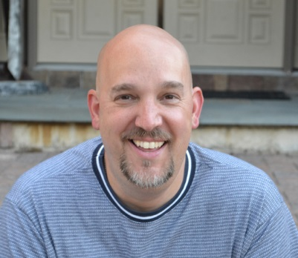
Share This eBook
I encourage you to share this eBook with friends, family, co-workers, or anyone who you feel could benefit from its words.
I ask that you share the complete eBook, as it is written, without changes, or omissions.
This eBook is meant to be shared, free of charge.
Thank you for your time, interest, and sharing my message.
Sincerely,
Peter F. Morneault
Be Kind. Be Thankful. Be Significant.
petermorneault.com

Slide 33
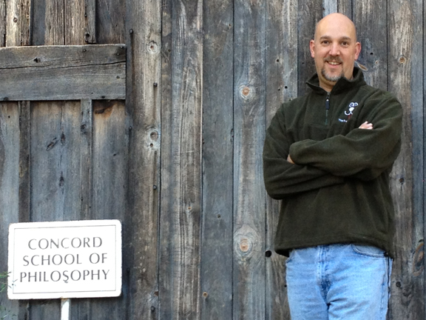
About Me
My name is Peter F. Morneault, and I am a writer, blogger, and teacher. I live in southeastern Connecticut with my wife, a pack of dogs, and a pride of cats.
I blog about finding wisdom and beauty in unusual places at: petermorneault.com
Stay connected and read more on:
Facebook: Peter Morneault
Amazon: More Books

